Slide 1

PASS Service Learning Project Introduction

Slide 2

Process
Brainstormed Success
Brainstormed Barriers to Success in Community (Northeast Philadelphia)
Voted on top 5 topics: Discrimination, Peer Pressure, Lack of Resources, Lack of Exposure to Opportunities, and Language

Slide 3

Process
Wrote 29 survey questions
Collected 153 surveys from classmates, teachers, family and community members
Analyzed data in 5 project groups

Slide 4
Demographics- What is Your Age?

Slide 5
Demographics- Race/Ethnicity

Slide 6
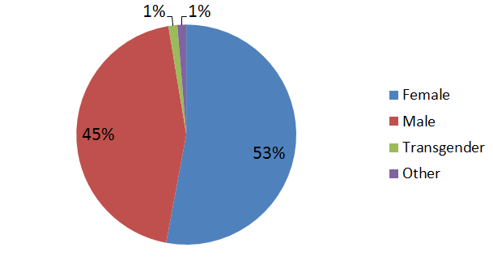
Demographics- Gender

Slide 7

What Each Group will Present Today…
Why each issue is a problem
Supporting/interesting survey data
Target community
Proposed solution
What steps have been taken
Action steps

