Slide 1
Lack of Resources
Kiyon
Amani
Viktoriya
Daika
EJ

Slide 2
Why It’s a Problem
Lack of resources is a problem for people who are trying to get a job due to lack of transportation.
Lack of resources can lead to loss of money, and job eligibility.

Slide 3
Process
Couldn’t identify any good data.
We made new surveys to get new understanding data.
Interviewed 26 students.
The resource that found to be most valuable was family.

Slide 4
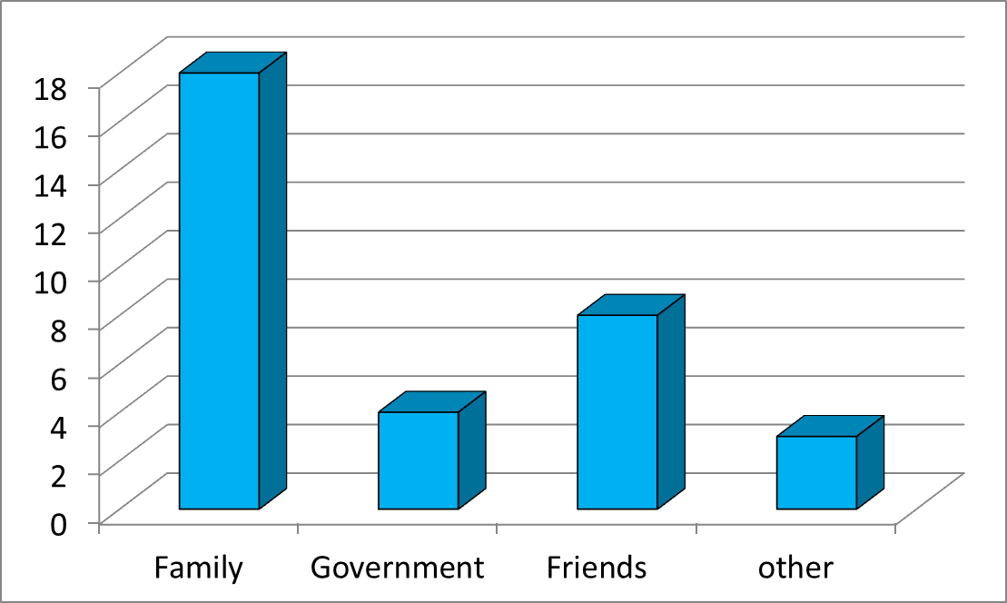
Data
How do you get the resources that you need? (Choose all that apply)

Slide 5
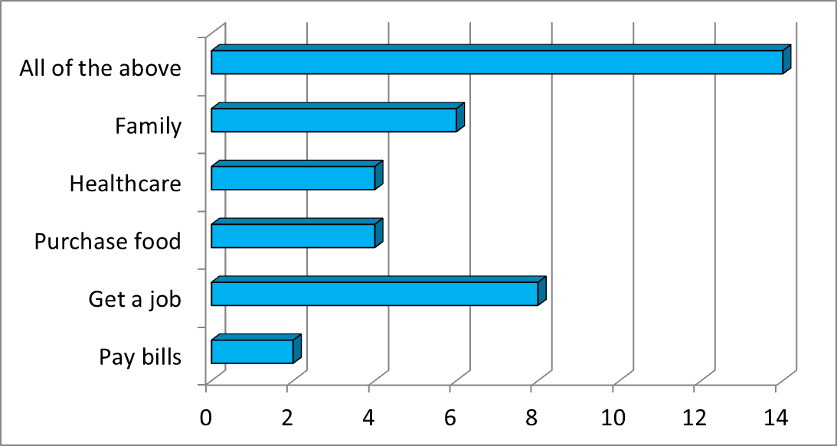
Data
Why do you need these resources?

Slide 6
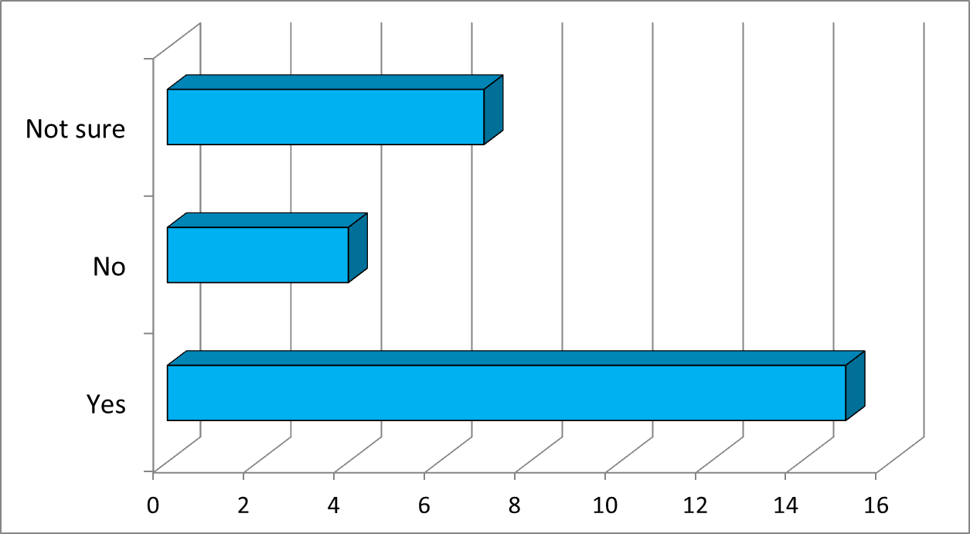
Data
Do you think lack of resources affects exposure to opportunities?

Slide 7
Solution
Homework Club
Students who need help with homework can come for practice.
What: Math, English, Science
When: Tuesday and Wednesday after school
Where: School library
Who: Teachers, students

Slide 8
Connection
Helpful for students who don’t get homework help at home.
Parents are working overnight
Parents don’t speak the language
Parent isn’t good at the subject
Parents attention is somewhere else

Slide 9
Action steps
Talk to principal for approval
Talk to teachers to tutor
Talk to students
Get a space reserved
Contact advisor of NHS
Hand out flyers to let students know about the program

Slide 10
Solution
Keeping a Close Knit Family
Have family dinners
Include every family member in any activities that are done
Be there when a relative needs help no matter how big or small
Always keep in touch with one another

Slide 11
Impacts of homework help
“Keep in mind that its their homework, not yours, but remain available in case you are needed.”
Is designed to help students reinforce key concepts
Most teachers use homework to find out what the student knows.
“If your child needs extra help or truly doesn’t understand something, let the teacher know.”

Slide 12
References
http://www.pbs.org/parents/education/going-to-school/supporting-your-learner/homework-help/

