Slide 1
Discrimination
Name: Govinda,Shivam,Robin

Slide 2
The problem and why it’s a problem….
Discrimination: A unfairness or unjust treatment of a group or a society upon Race, religion, gender, and culture.
Leading factors
People treating others differently
Destruction of nations
Brings segregation amongst people
War, riot and chaos
Lack of understanding

Slide 3
Supporting Data...
153 people were surveyed from northeast philadelphia including G.W.H.S.
53.64% say that they are being discriminated by their race.
39.74% say that they are also being discriminated by their religion.
37.75% say that they would confront someone discriminating against someone else.

Slide 4
How are people discriminated against?

Slide 5
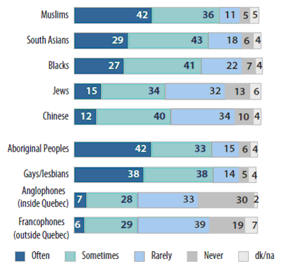
Target community…...
Northeast philadelphia
Friends/peers
Church community
Neighbors
Teachers
Schools
Workplaces

Slide 6
Proposed Solution……
To create more awareness in the community about this issue.
Mini podcast – interview people in our community and share their thoughts and experiences about discrimination.

Slide 7
What have we done so far?

Slide 8
What we plan to do…
Share with community:
Social media
- Youtube
- Facebook
JEVS website

