Slide 1
Peer Pressure
Nyderia Bullard
Johanna Barnes
Regina Pierre
Vladyslav Shypulin

Slide 2
Peer Pressure
According to Lauren Sherman, a lead author of research conducted on peer pressure via likes on social media at University of California, “peer pressure may play a critical role in teens’ accrual of social and cultural knowledge that’s essential to their development… It’s how teenagers learn the rules of how to communicate and how to develop relationships.”

Slide 3
Positive and Negative
Positive Peer Pressure
Seeing your friends getting good grades in school can push you to work harder.
If you left school and you see your friend in college trying to make it work that might push you to want to do the same.
Negative Peer Pressure
Your friend might smoke weed, and if they offer you some, you might end up being a smoker yourself.
Your friend is cutting school and invites you join and because you would like to remain friends, you follow along.

Slide 4
Problem and Why it the a problem…
Peer Pressure is a problem because it makes people do things that they do not want to do and it could have negative consequences to it.

Slide 5
Other Research
During the research we interviewed 8 people
Surveyed 15 people
We read articles

Slide 6
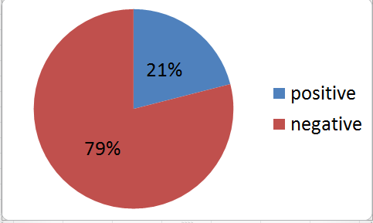
What type of peer pressure is more popular?

Slide 7
Why do think peer pressure rates are so high?

Slide 8
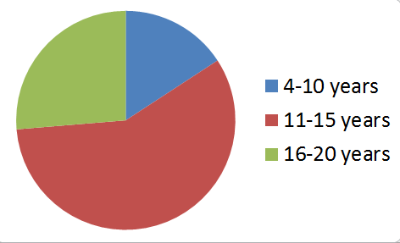
How old were you when you first experienced peer pressure?

Slide 9
Can you describe your personal experience with peer pressure ?
One girl went to the hospital and the class pointed at her and said “cutter” and she ended up getting home schooled.
“ My family members drink and they would try to get me to drink with them but I said no”

Slide 10
How did you feel when you gave into peer pressure?
Humiliated, helpless, depressed, and haunted
Then others said that they felt cool, it felt fine, or nothing at all.

Slide 11
What did you do to get out of it?
They became more assertive basically by fading away from people that they knew weren’t doing the right thing.
Saw a psychiatrist

Slide 12
From your experience, what can you do to stop peer pressure?
Don’t put yourself in bad situations, and avoid being with bad people.
Be home schooled

Slide 13
Target Community
Washington High School
Local Middle Schools

Slide 14
Action steps
Have organizations that target peer pressure come in and talk to students
Tell classmates or friends about PGC
Create a program that will allow you to talk to 7th and 8th grade students about peer pressure

Slide 15
What Has Been Done
Emailed Director of South Philadelphia Prevention Coalition (SPPC) to ask them to come speak to students about peer pressure, drugs and alcohol.
Reached out to middle schools and make appointments to speak to students about peer pressure.
All said that this time of year was too busy

Slide 16
What Still Needs to Be Done
Reach out to middle schools in the fall
Come up with presentation for middle schools
Confirm date, time and location for SPPC to come in and speak
Advertise event

Slide 17
Sources
https://well.blogs.nytimes.com/2016/06/14/for-teenagers-the-pleasure-of-likes/

